Slide 1
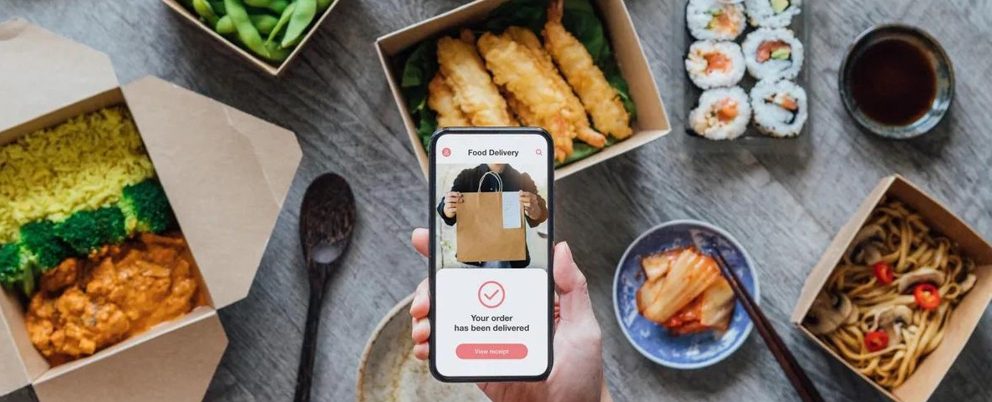

Pitch Deck
23 Arellano Street Dagupan, Pangasinan
jmexpressFD@gmail.com support@fjmexpressFD.pk
JM Express
Food Delivery
+63 9164739421

Slide 2
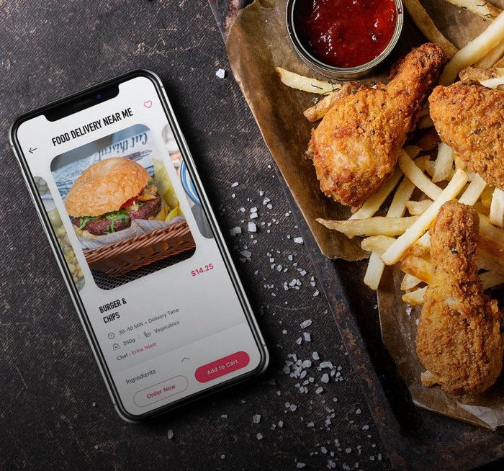
Summary
During the Covid-19 epidemic, online food delivery had a huge influence in the Philippines. It has been demonstrated that internet meal delivery benefits clients. Looking at it from a broader viewpoint, Online Meal Delivery serves as an excellent concept for customers because you don't have to stand in line, go to restaurants, cafes, or fast foods to get your food.

Slide 3

Problem
Problem 1
Late Deliveries, Incorrect Orders
Several major issues that customers experience, includes late deliveries, incorrect orders received, and orders not being delivered. Others also experience,unfriendly customer service, and cold food.
Some of the most serious issues were the items not being delivered and the driver needing a lot of help identifying the delivery address.
Problem 2
Limited Areas, Wrong Address
Problem 3
Cold Food, unfriendly customer service

Slide 4
Solution
JM Express Food Delivery has put in place proper measures in place to ensure that drivers handle food properly and safe.
Solution 1
Hassle Free
Solution 2
Save Money
Solution 3
On Time

Slide 5

Product/Services

Slide 6
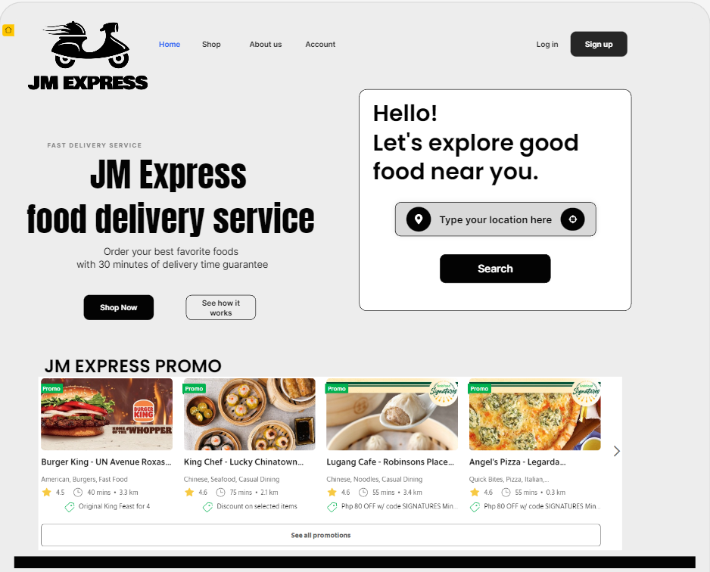

Product/Services
New and improved website for an intuitive user experience
Get the best deals with promo and discounts vouchers.

Slide 7
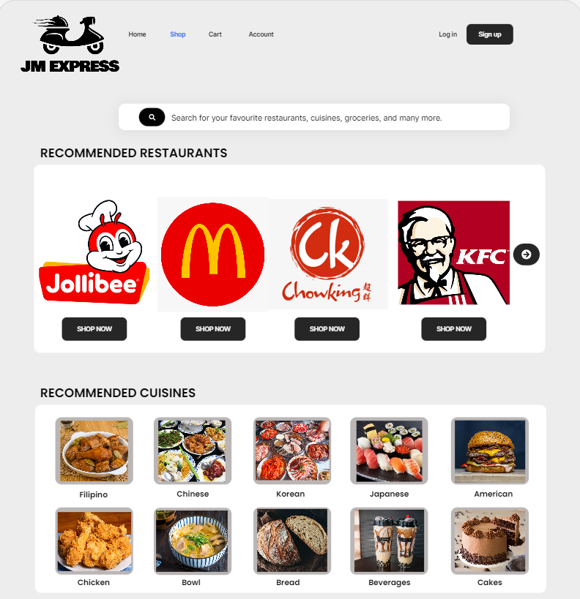
Product/Services
-Get your favorite cuisine quickly with recommendations and order straight through the shop.
The Shop offers many variants of food to choose according to the customer’s liking.

Slide 8
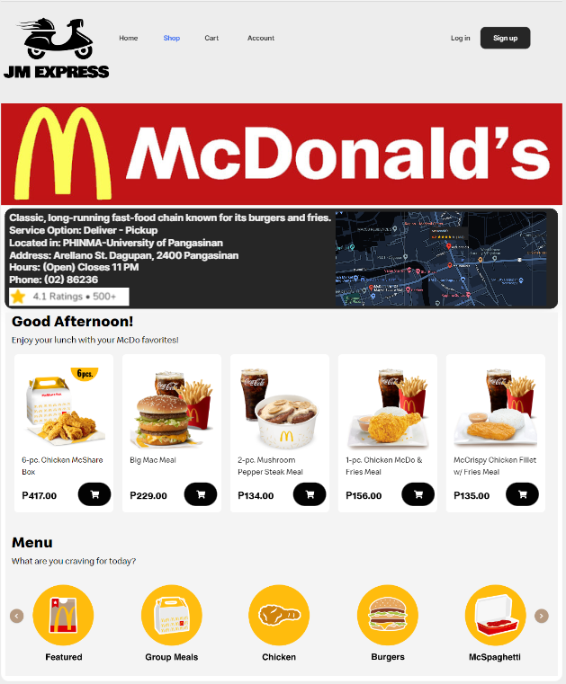
Product/Services
Easy to find what you want
Can stack up your orders in a cart

Slide 9
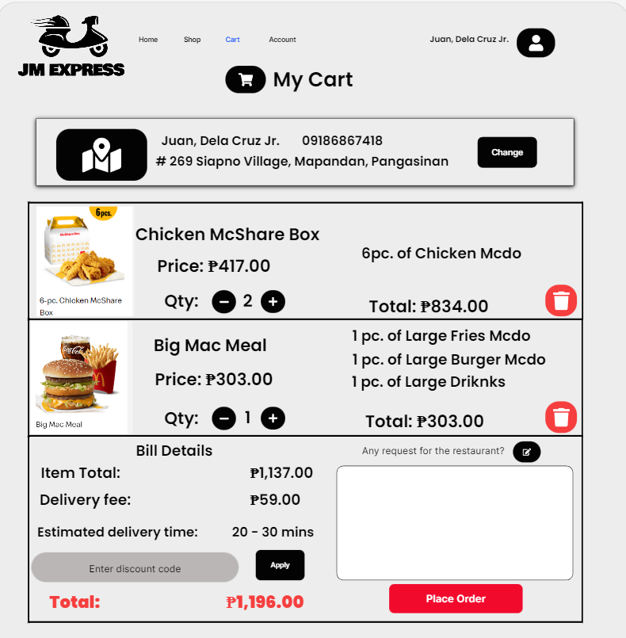
Product/Services
Easy to track and check out orders
Can make request or note to the restaurant and rider
With 3 easy steps you can make your order

Slide 10

Target Market
18 - 40 AGE
Most of the online food delivery demands come from the age group of 18-40 years whereby 65 % of the target market is below 35 years of age and most of them are:

Slide 11

College Students
or Young Adults
As college students and young adults like us who live fast-paced lives. With classes, active social lives, and new careers, there is no time for us to think about what to make for dinner, so most of us prefer to just order online because it is more convenient.

Slide 12
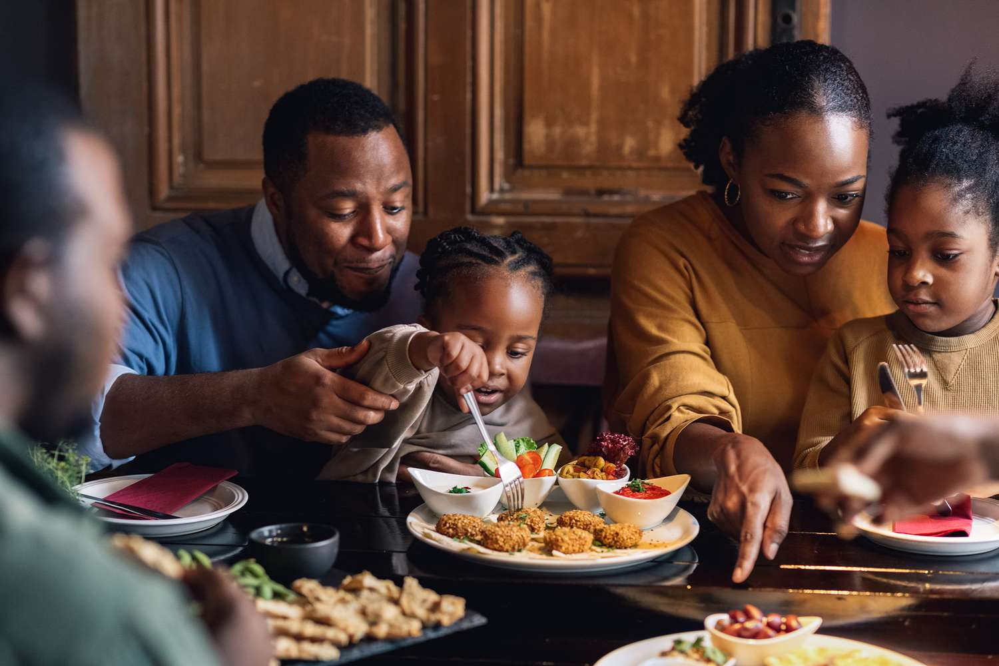
Parents
We all know that all parents have endless to-do lists, and parents can feel overwhelmed when planning a meal at the end of the day. Meal delivery services are a great option for busy parents and families. Not only will it save them time from going to the grocery store, but it gives them the chance to cook with their kids, without all of the extra work of food preparation. Cooking dinner becomes less of a hassle and more of an experience by using food delivery services.

Slide 13

Working Professionals
Coming home tired from work, that's what working professionals often experience. So most of them don't feel like cooking anymore to make their food, so food delivery services become their partner to survive on their meals every day because it’s saves them time and they feel it more convenient.

Slide 14







Competitors
More Convenient
Less Affordable
More Affordable
Less Convenient

Slide 15



Marketing & Sales Acquiring customers
GROWTH STRATEGY
How we will scale our business
Incentives program for trustworthy riders. Offering discounts and deals to customers. Reward users with promotional deals.
Customer Service Keeping customers
Respond quickly to all customers feedback. Have a connection with users.
Broad and secure payment option.
Product Development Staying competitive
Efficient customers and order management.
The convenience of mobile ordering. Stay ahead of competition

Slide 16
Students Parents Professional
125
Traction
100
75
Revenue/ customer growth
50
25
0
2022
2023
2024
2025
2026

Slide 17
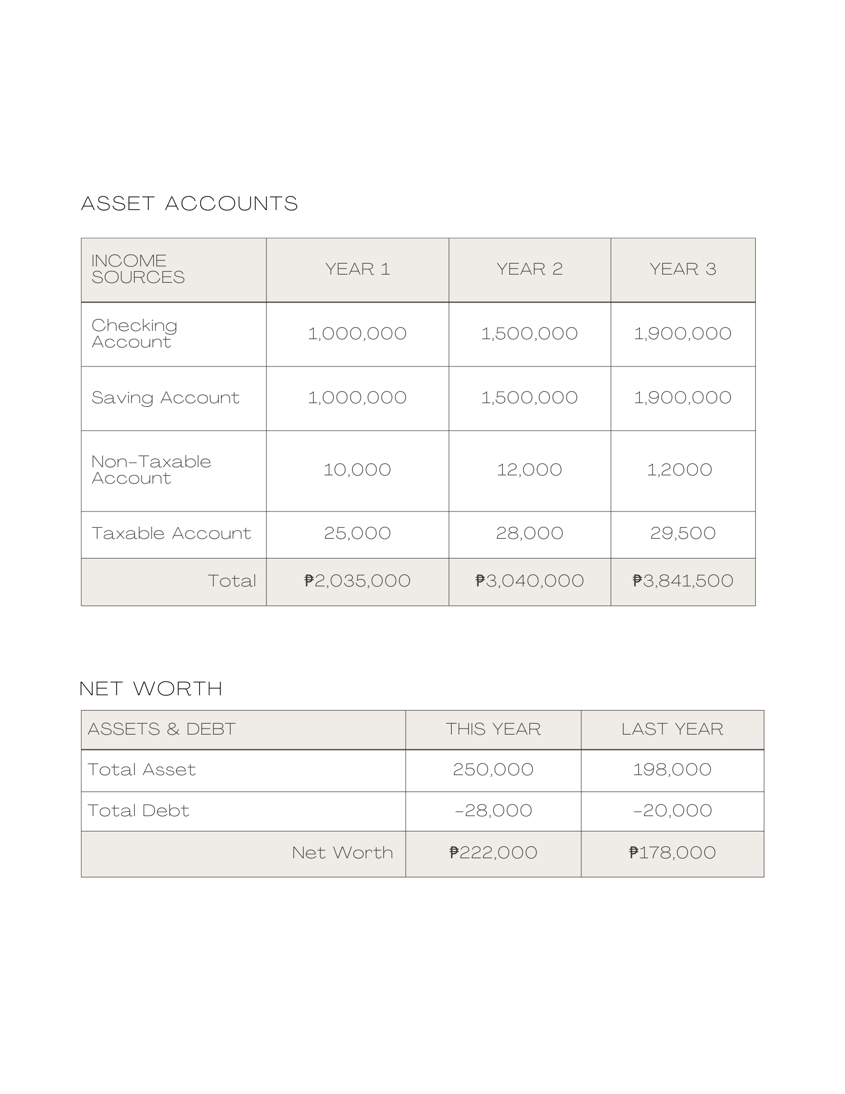
Financial

Slide 18








Funding
Personal Savings
Bank Loan
Look for Investors
GoFundMe

Slide 19
Funding
We will combine the savings we we have accumulated or earned from our works and other businesses
Personal Savings

Slide 20
Funding
We will obtain a personal loan from our current banks and search around for good deals
Bank Loan

Slide 21
Funding
We will look and search around for possible investors for our venture
Look for Investors

Slide 22
Funding
We will use GoFundMe as our new age ways of gaining capital, GoFundMe is one of the most popular crowdfunding platforms for personal fundraising spaces.
GoFundMe

Slide 23
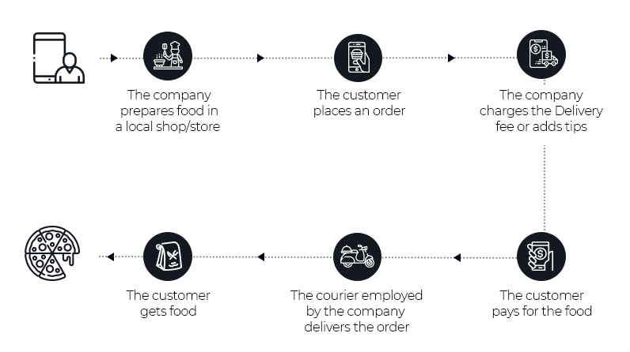
Business Model
Show the ways your company plans to make money.

Slide 24

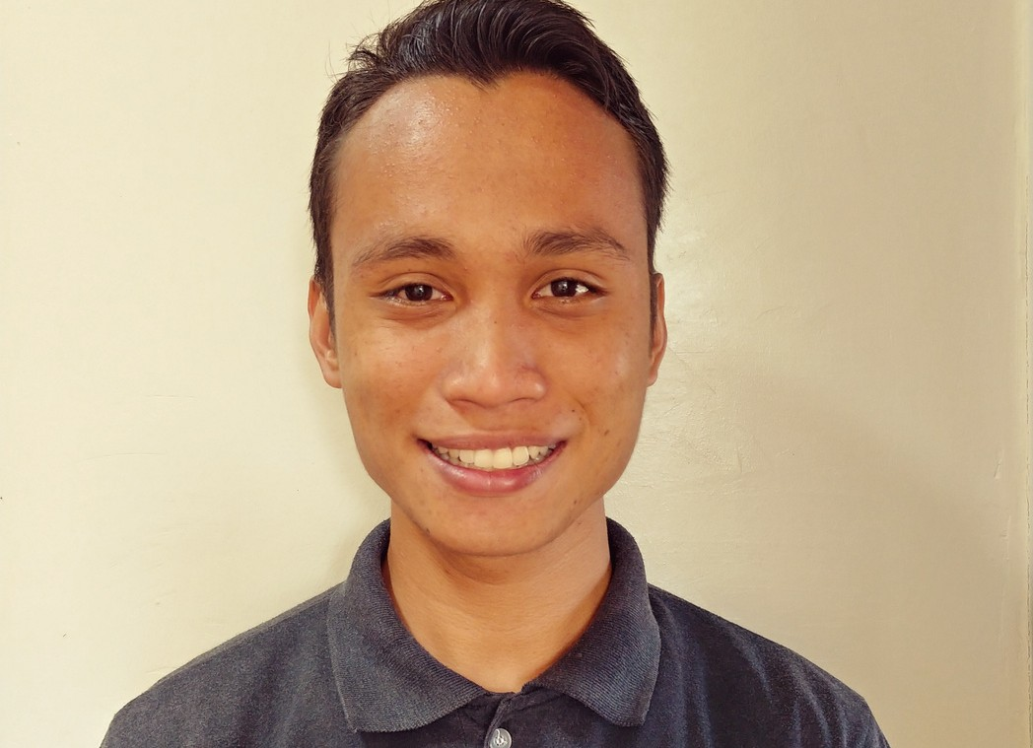

JAMAICA ALBAN FOUNDER
Meet the Team
MICHAEL DISO PROJECT MANAGER
MARK ANTHONY SIAPNO FRONT-END DEVELOPER

Slide 25
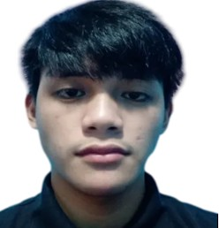
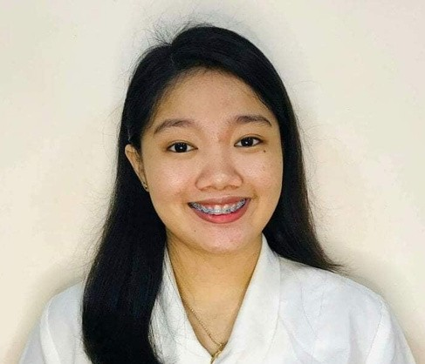

JOSHUA QUISAO BACK-END DEVELOPER
Meet the Team
JESSA UGABAN DESIGNER
MAC GILNER MANES QUALITY ASSURANCE

Slide 26





Thanks for Viewing!
23 Arellano Street Dagupan, Pangasinan
jmexpressFD@gmail.com support@fjmexpressFD.pk
+63 9164739421

